Slide 1


MULTIPLAYER SNAKE GAME
DEEPAK RAJAN S |  | 160501039
DOMAIN: | Artificial Intelligence
Date of Review | 15.10.2019

Slide 2
ABSTRACT
The purpose of this project is to make the player compete with
each other on a multiplayer snake game and make the computer
reflect the moves that the players have used in their previous
games .The model is demonstrated in browser so this game is
developed using the basic SSE server push mechanism and
record the player’s move in a one on one battle with each other
And tries to use the previous player’s move. The computer uses
the shortest path algorithm to reach the target with out having
self Destructive moves and tries to escape from the opponent’s
attacking moves by predicting it before.

Slide 3
PROBLEM STATEMENT

Slide 4
PROBLEM STATEMENT
To develop an multiplayer snake game to facilitate the user to play with other users as well as with the computer .
Why multiplayer snake game ?
It is one of the popular game in the earlier models of mobile phones.
Still many people are trying to develop the newer version of this game.
Why multiplayer snake game ?
It is more competitive than a single player snake game .
The player has more interest in playing with other players or their friends .

Slide 5
SCOPE AND JUSTIFICATION
To collect the data from user using a snake game and develop computer that plays like a human player
In this project the snake can detect shortest the path to the co-ordinates of the food and can predict the opponents move make a counter move to escape from players attack.
The need to implement this project is to add feature to game by introducing a computer snake which can make more interesting.

Slide 6
INTRODUCTION

Slide 7
SINGLE PLAYER SNAKE GAME:
Game board consist of 2 dimensional space which has walls at the borders.
An User’s Snake is allowed to move around the 2-D space without dashing the wall.
A symbol denoting the food will randomly paced anywhere in the 2-D space.
If the user catch the food, length of the snake body increases
The food will be available only for few seconds.

Slide 8
WINNING STAGE FOR SINGLE PLAYER GAME MODE
There is no exact ending point for this mode ,The player can continue playing as long as he did not hit the wall or bites his own snake body.
So the major challenge in this type of game is to decide the correct path to get the food and to continue survival.
CHALLENGES IN SINGLE PLAYER MODE GAME:
Keeping the survival rate of the snake is difficult
Finding a best path to reach the target without compromising the survival rate

Slide 9
ROLE OF AI IN SINGLE PLAYERE MODE
To find the optimal path to reach the food Co-ordinate with out hitting the wall or biting the body.
To avoid the failing situations and to increase the survival time .
To find a path that leads the snake to food by avoiding the obstacles.

Slide 10
ALGORITHMS TO FIND SHORTEST PATH
Greedy Path Finder
2. Hamilton Path finder
3. DQN Path Finder
4. Breadth First Search
5. Best First Search
6. Dijkstra

Slide 11
PATH FINDER
This project uses the BFS Algorithm for finding the path in the game board grid
Reasons to use BFS :
The important reason to use the BFS algorithm is to maintain the movement of the computer snake.
Advantages of BFS :
BFS provide the guaranteed path if it exist.
It checks every possible path to reach the target.
The first path found by this algorithm will be optimistic solution.

Slide 12
MULTIPLAYER SNAKE GAME (INSTRUCTIONS)
In this mode two snake move across the board simultaneously and they fight for the same food.
Like single player mode here also the snake’s body length increases when it gets the food.
Advantage of the multiplayer over single player is that it has game bound that is when a snake bites the another snake’s head it wins.

Slide 13
CHALLENGES IN MULTIPLAYER SNAKE GAME
To predict the opponents next move
To make decision whether to go for a food or try to attack the opponent.
Reading the user’s move and making use of the previously collected data to make the next best move.

Slide 14
PROPOSED SOLUTION - ARCHITECTURE DIAGRAM
Computer
User U3
User U2
User U1
Game Board Controller
User Controller
Game Board Manager
Request Handler
Live User Lister
Instance of the game board
Data Collector
User moves database
Predictor

Slide 15
MODULES

Slide 16
MODULES
Live User Listing Module.
2. Game Controller Module
3. User snake Controller Module
4. Game Synchronizer Module.
5. Data Collection Module.
6. Prediction Module

Slide 17
DATA COLLECTION PHASE
Data collection happens when a user changes his snake’s current moving direction.
The next move column of the data sheet is determined by the move followed by the current move.
When a user press a arrow key an AJAX call with the following parameters are sent to the server for storing
JSON Object of red snake.
JSON Object of blue snake.
Head position of red snake.
Head position of blue snake.
Length of both the snake.
Current moving direction of both the snakes.
Distance between the X co-ordinates of the snake heads.
Distance between the Y co-ordinates of the snake heads.
Distance between the food and the snakes.

Slide 18
SYSTEM REQUIREMENT

Slide 19
HARDWARE AND SOFTWARE REQUIREMENT
Hardware Requirements :
1. RAM:2GB
2. PROCESSOR : AMD A4-4300 2.50 GHz
3. GRAPHIC CARD : NOT REQUIRED
Software Requirements :
Java V 1.8
Tomcat Server
MySQL server
MySQL Jconnector API
org.JSON API
Servlet API

Slide 20
IMPLEMENTATION OF MODULES

Slide 21
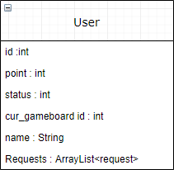
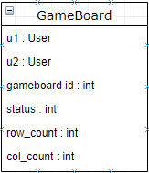

IMPLEMENTATION OF MODULES
Live User Listing Module :
The live user listing module is server push process in which push the list of users available to play.
The user continue keep track of the new user getting added to the game .
It sets the retry time as 110 milliseconds which quite enough to get instant updates of he live users.

Slide 22
GAME CONTROLLER MODULE
After the user get his id and assigns a name to him ,he will be redirected to a game page where he get to know the current live user .
User can give Request to other user by just clicking his name on live user bar
Then the request is added to the request list of the recipient user.
If the user on the other side click decline then request disappears without taking any action else if he/she select accept button then the both users will get into the new game.

Slide 23
GAME CONTROLLER MODULE (Contd)
A single user can give request to n number of live user but once he get into play another user he/she cannot abort the game.
If the user wants to play with computer he can click “PLAY WITH COMPUTER” button .
Once a user accepts the request the following operation takes place :
A new game board is created
Both user’s id is registered to particular gameboard
Status of the both the user are set as ‘busy’
Game start flag is set.

Slide 24
GAME CONTROLLER MODULE (Contd)
If he/she decline the request then the particular request is removed from the receiving user’s request list.
The above operation is done by the class called “ getid ” which has the operation for value of ‘ t ’
Operation Code | Action
0 | Creating new user ID
1 | adding request to recipient request queue
2 | adding two users to game and starting it
3 | Reports the snake status to server
4 | food acquired signal
5 | Report the addBodyPart or removeBodyPart Operation
6 | save the current snake to database
7 | flag reset signal
8 | game end signal

Slide 25
USER SNAKE CONTROLLER MODULE
Unlike the previous implementation of the game in which entire game data is maintained in the server ,in this model the snake movements are localized.
In this game the user has four movement controls left ( ← ) ,right ( → ) ,top ( ↑ ) and down ( ↓ ).
On pressing any of these button a key code is sent to a function with in turn checks the user’s id and report the server about local changes of the snake .

Slide 26
USER SNAKE CONTROLLER MODULE
The receives the report and push it to its listeners and listeners gets the announcement from the server and makes the changes to the local game board.
The following changes of the local game board is reported to the server
Snake’s position changes
Addition of body part to a snake.
Removal of body part to a snake.
When body part count of any snake gets below THREE( 3 ).

Slide 27
GAME SYNCHRONIZATION MODULE
The game synchronization is purely for synchronizing the user’s local game board on a particular event.
What if the entire game is maintain in server side instead of giving it to a client agent like browsers ?
Though when a game board on server side gives a perfect synchronization localization of game board is done.
The reason is operational overhead ,this is due snake’s movement in the game board is time consuming ,if we make such a time consuming process run on the server side then facilitating multiple game simultaneously will become a tedious task.

Slide 28
GAME SYNCHRONIZATION MODULE (Contd)
In this project the basic level of synchronization involves an important task to be done ,that is start time calibration .
START TIME CALIBRATION
The start time calibration process depends on the Timestamp of the listeners and the retry header of the event generated by the server.
When one client starts listening to the server too earlier then the other have to be calibrated the correct timestamp.
For example if the u1 start listening at 50th ms and u2 starts listening from 80th ms then (80-50)=30 ,so the retry time for u1 is 110 ms whereas for u2 it is (110-30) = 80ms.
Thus next both will listen at 160th ms.

Slide 29
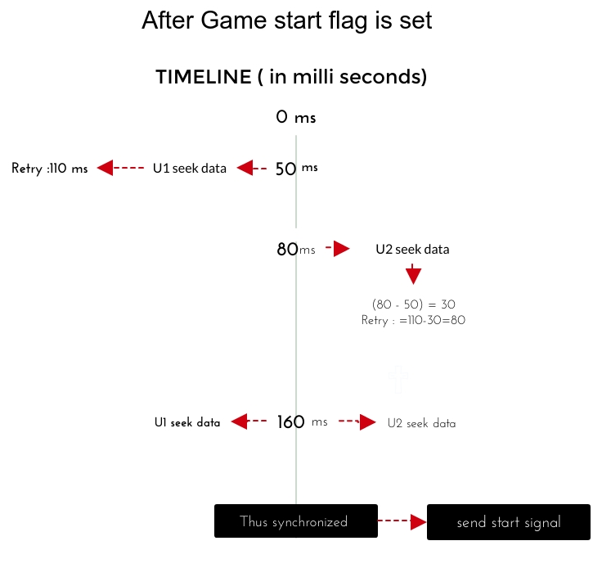
GAME SYNCHRONIZATION MODULE (Contd)

Slide 30
GAME SYNCHRONIZATION MODULE (Contd)
OTHER SYNCHRONIZATION REQUIRED :
1. Snake position synchronization
2. Body part change synchronization
3. Food Synchronization
Every synchronization happens by flags .
Both Snake position and body parts are synchronized by flag values and event stream sent by the server.
But the food Synchronization is not implement using flag values it is fully dependent on the start time calibration ,incase of the timestamp not synchronized then the game will be paused for both and will be started again once timestamp gets synxhronized.

Slide 31
DATA COLLECTION MODULE
The data collection module is a important module since the main objective of the project only on a good dataset..
The data is collected every time when a player presses any of the arrow keys.
Once the arrow key pressed the snake’s data and the food data is sent to getid module with a operation code ‘ 6 ’.
METHOD USED TO RECORD THE USER’S NEXT MOVE IN TABLE
Initially the next move column is set as ‘ -1 ’.
Once the press any of the arrow key ,the server set update the table with the current direction value where the next move was set as ‘ -1 ’.

Slide 32
PREDICTION MODULE
The prediction module is used to predict the next move of the player with the data collected from the previous games.
The analyzer module returns the next predicted move of the player if possible else it will return ‘ -1 ’.
On the client side the computer’s snake maintains an imaginary boundary around it to detect the opponent snake’s existence near it.
Once the opponent is detected within the boundary it send the current game board situation and gets the predicted move.
The prediction is purely based on the probability values .

Slide 33
PREDICTION MODULE (Contd)
The Analyzer Module uses the Naïve the Bais Classifier to predict the next move of the player with the given parameter value.
This predictor uses the 8(eight) parameters to classify the new data entering the module.
If the data is sufficient then it will compare the probability value and give the classification result back to the client.

Slide 34
PREDICTION MODULE (Contd)
If the data is not sufficient then it return ‘ -1 ’
The following Parameters are used to classify the test data.
Head position of opponent
Length of the opponent
Food position
Current direction of the opponent
Distance between opponent and food
Distance between opponent and computer snake

Slide 35
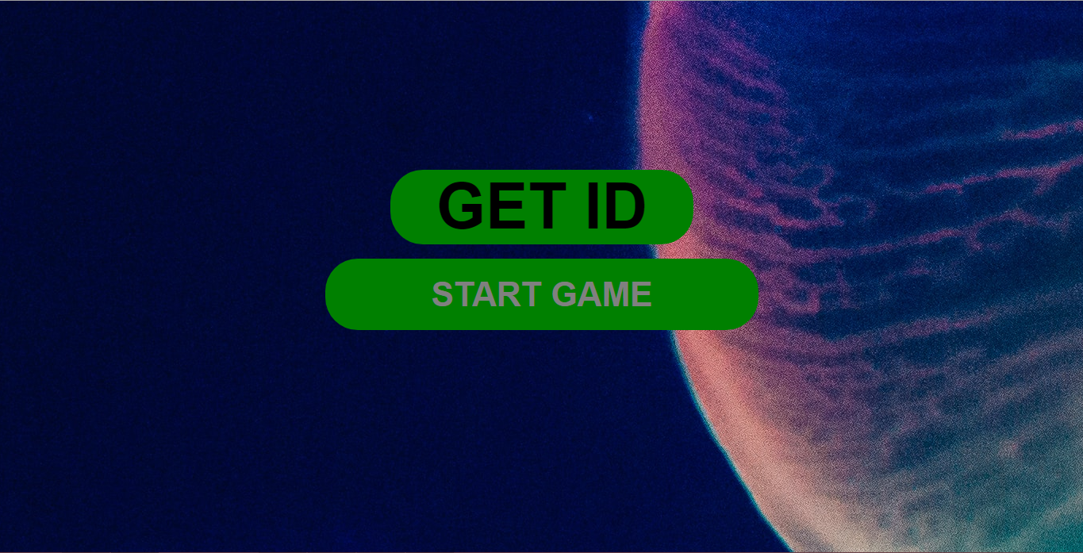
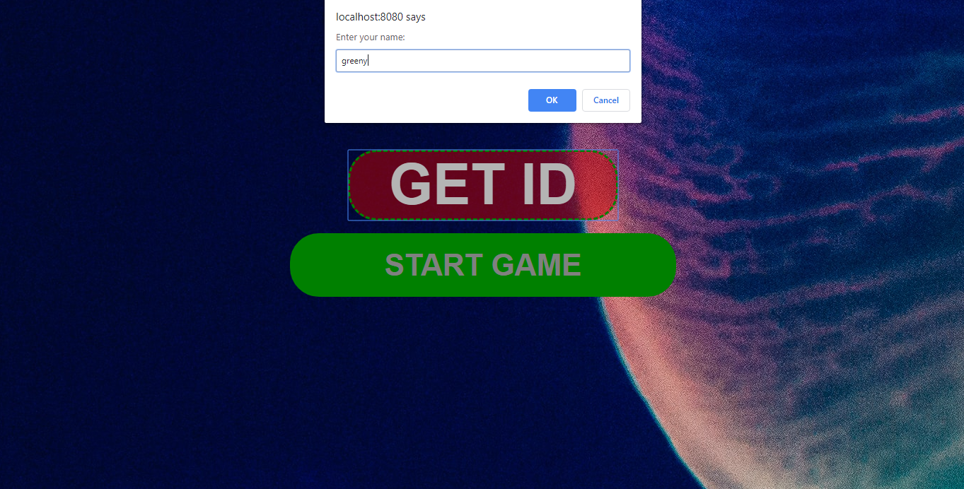
SNAPSHOT
Home page
Getting ID

Slide 36
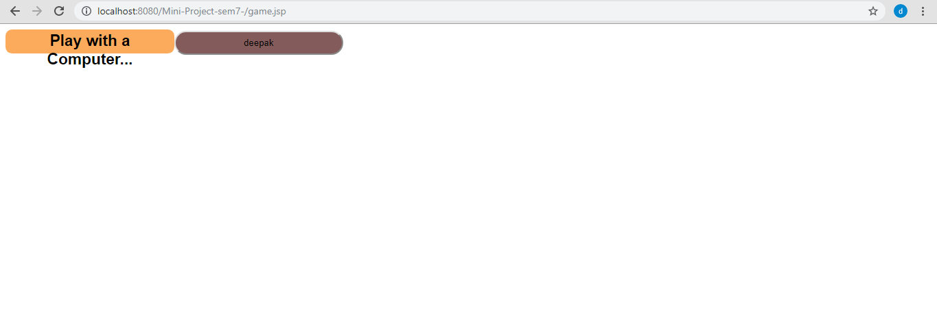
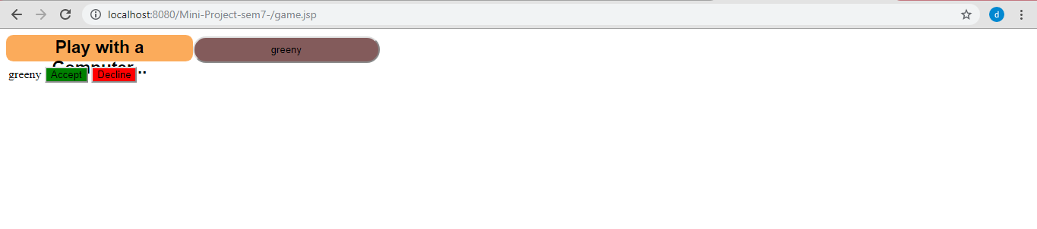
SNAPSHOT
LIVE LISTER BAR
REQUEST BAR
User U1 -> live user bar
User U2-> request bar

Slide 37
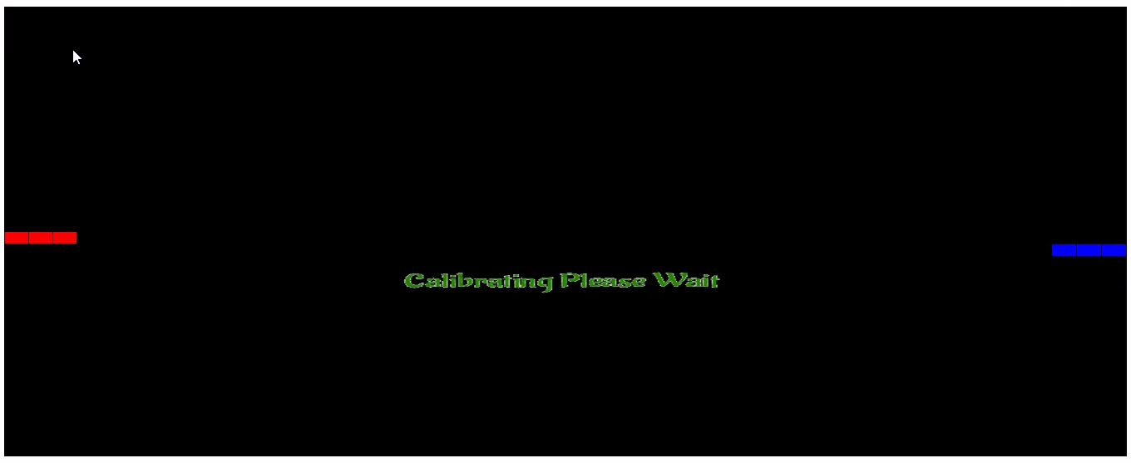
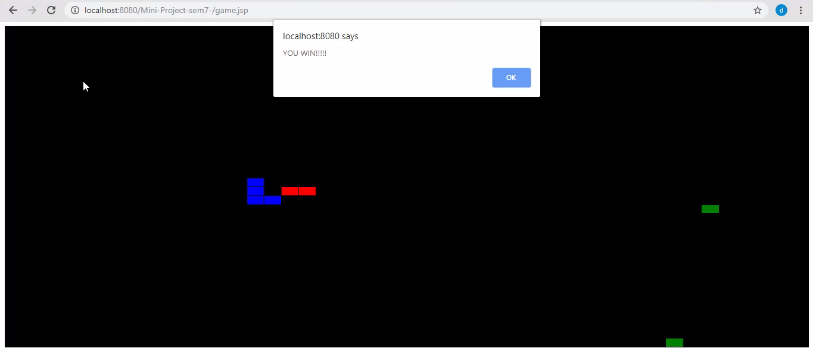
SNAPSHOT
Calibration of the game board
Game end

Slide 38
CONCLUSION AND FUTURE WORK
CONCLUSION :
1. Thus a game with could be played in multiplayer mode from separate devices is developed
2. Collected the user moves data.
3. Did a prediction on collected data for helping the computer snake to have a better moves again the human a opponent.
FUTURE WORKS :
1. Construct a more efficient model to predict a more personalized user move
2. Enabling more than two players to play on a single game board.
3.Enabling the dynamic game board size.

Slide 39
THANK YOU

